Slide 1

Develop a Web-Based Election Document Builder
Daniel Calle | Ivan Kwok | Lance Tieng

Slide 2
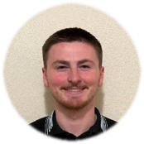
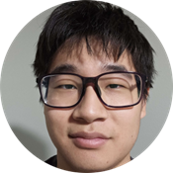
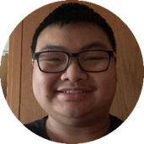
Introduction

Slide 3
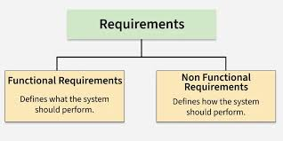
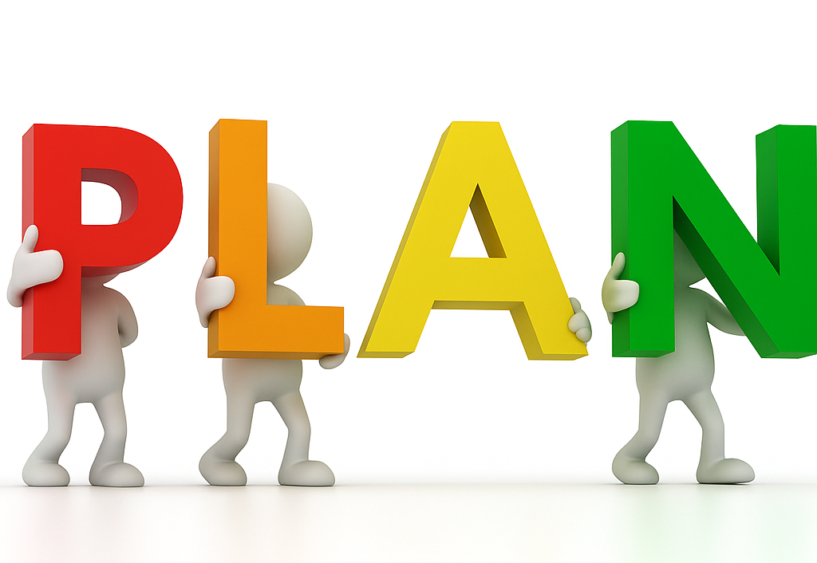
Objectives
Understand the tech stack and problem statement.
Meet with and discuss deliverables from client.
Setup our initial schedule and timeline with our client.

Slide 4

Client Meetings
Meeting 1: We discussed the project we will be working on, the tech stack, and what roles everyone will have throughout the semester.
Meeting 2: We were introduced to a Senior Engineer at the company who discussed further meeting times as well as signing and NDA to discuss project details further.
Meeting 3: The Senior Engineer discussed the tech stack in great detail and gave us some actionables and links to things that we can start work on.

Slide 5








Frameworks

Slide 6

Key Goals and Client Struggles
Increase efficiency in election management via the election document workflow
Current method is slow and not suited for large quantity of daily elections

Slide 7

How clients are currently handling things
Inefficient document creation via Word
Not ideal for large quantity of daily events

Slide 8
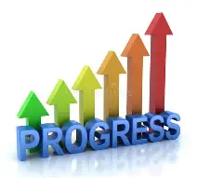

Summary
We learned the tech stack and have done some research on the technologies we will be using in this project.
We understand the requirements our project will need to fulfil and which team members will be doing what features.
We have set up weekly meetings with the clients to discuss progress.

Slide 9

Artificial Intelligence (AI)
Project Assignment 1 - revisions and additions offered by ChatGPT

Slide 10
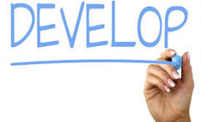
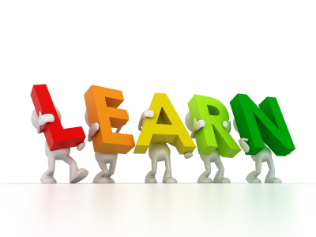
Goals for next sprint
Wrap up requirements and specifications
Start development
Learn

